Slide 1
6 Jars of ML

Slide 2
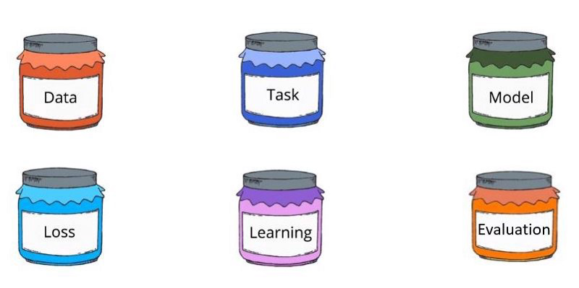
6 Jars

Slide 3
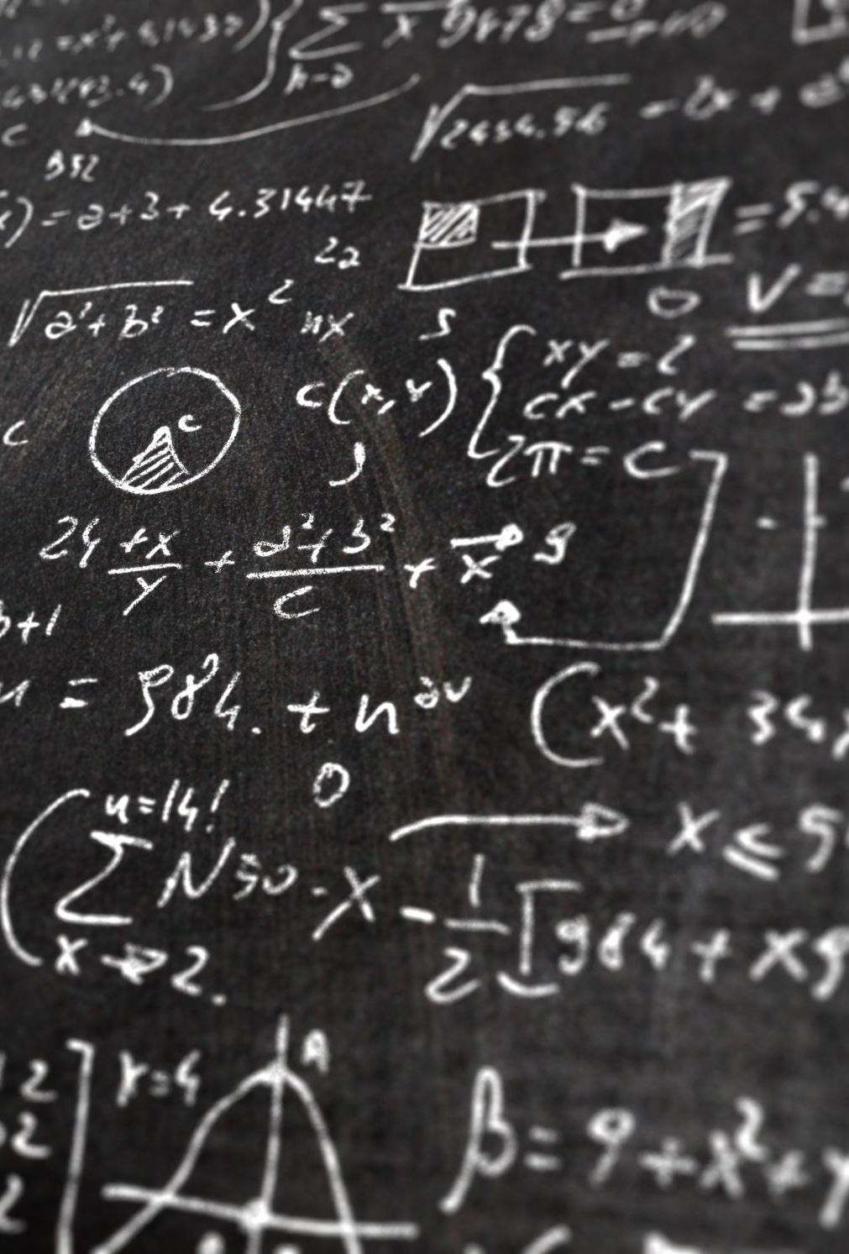
Data
All Data should be in numeric in nature
Check whether we have both input (feature) and output (target)
If Yes → Supervised ML
If the output – Numeric/continuous – Regression task
If the Output is Categorical – Classification task
If No → Unsupervised ML

Slide 4

Tasks
If the Output variable is continuous – Regression
If the output variable is categorical – classification/discrete (if I have less that 20 discrete values)
Unsupervised :
Clustering – if the task is to create groups
Recommendation system – if the task is to recommend the items

Slide 5
Model
Classification :
DecisionTreeClassfier
RandomForestClassifier
LogisticRegression
SVC
AdaBoostClassifier
GradientBoostClassifier
Regression:
LinearRegression
DecisionTreeRegressor
SVR
RandomForestRegressor
AdaBoostRegressor
GradientBoostRegressor
Clustering : KNN
Recommendataion : Apriori

Slide 6
Loss Function/Evaluation Function (applicable for Supervised Learning)
Regression :
Mean Squared Error
Mean Absolute Error
Root Mean Squared Error
Mean squared log error
Classification:
Accuracy
Entropy
F1 Score
Precision
Recall

Slide 7
Learning Algorithm
This Describes how a model learns the pattern in the dataset

